Slide 1


Slide 2
The main difference between Centre of Gravity and Centroid is that the Centre of Gravity refers to the point where the total weight of the body is concentrated
the Centroid the refers to the geometric Centre of an object.
Centre of Gravity denotes the total weight of an object with any density.
In other words, centroid is the geometrical Centre of a figure. We use the term centroid for two dimensional figures, i.e., areas, e.g., rectangle, triangle, circle, semicircle, sector, etc.
We have assumed so far that the attraction exerted by the earth on a rigid body could be represented by a single force W. This force, called the force of gravity or the weight of the body, was to be applied at the center of gravity of the body

Slide 3

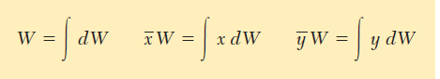
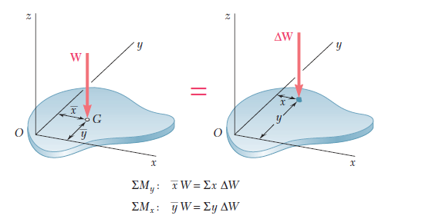
These equations define the weight W and the coordinates x and y of the center of gravity G of a flat plate. The same equations can be derived for a wire lying in the xy plane

Slide 4
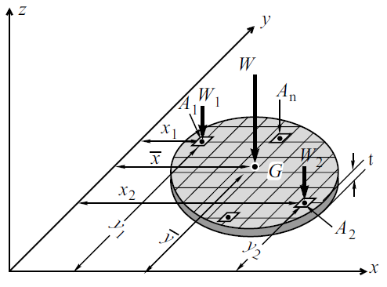
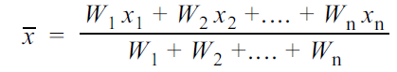
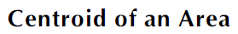
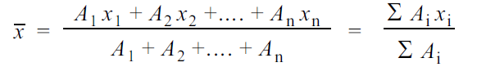
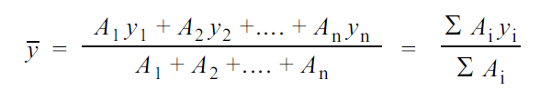

Slide 5
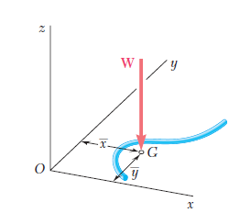
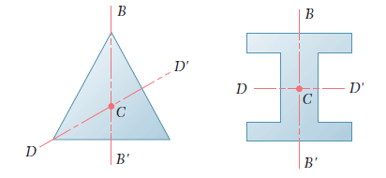
We note that the center of gravity G of a wire is usually not located on the wire.
Center of gravity of a wire.
if an area or line possesses two axes of symmetry, its centroid C must be located at the intersection of the two axes. This property enables us to determine immediately the centroid of areas such as circles, ellipses, squares, rectangles, equilateral triangles, or other symmetric figures as well as the centroid of lines in the
shape of the circumference of a circle, the perimeter of a square, etc.

Slide 6
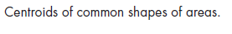
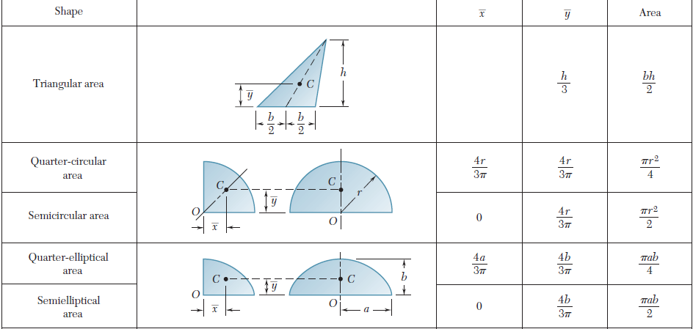

Slide 7
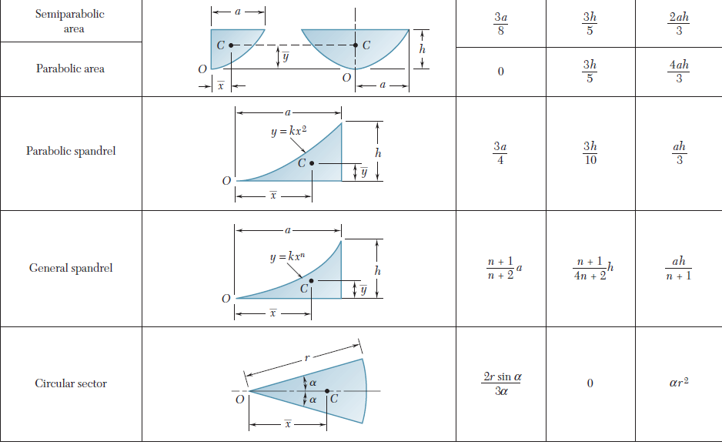

Slide 8
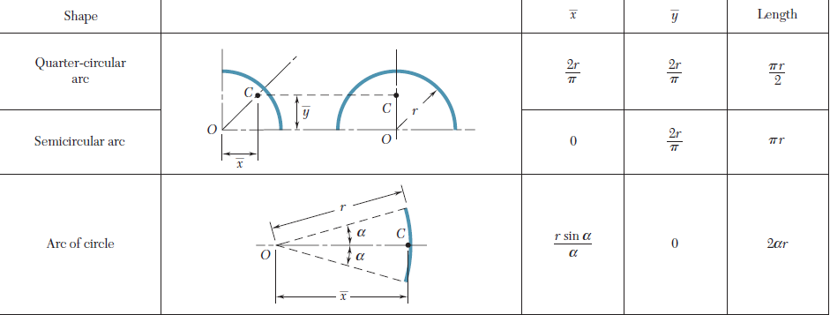

Slide 9

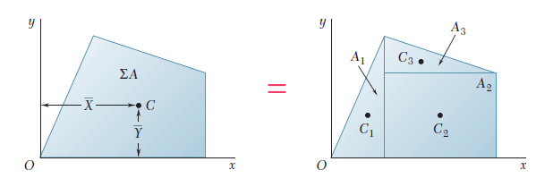
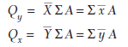

Slide 10
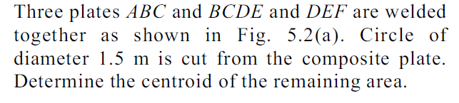
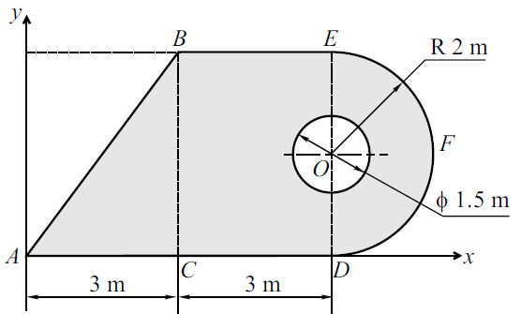
Problem 1

Slide 11
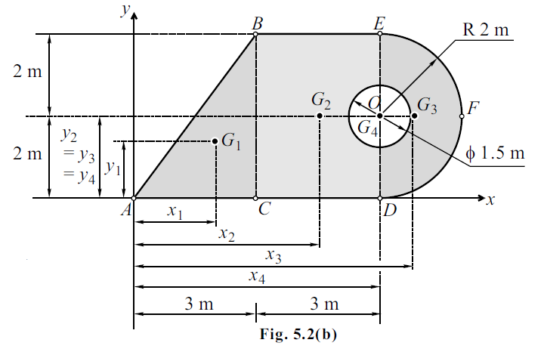
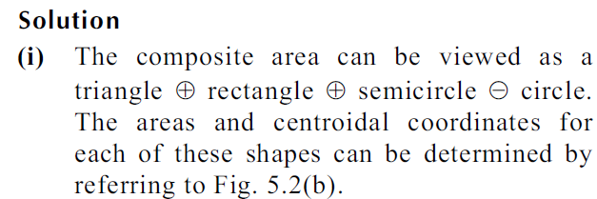

Slide 12
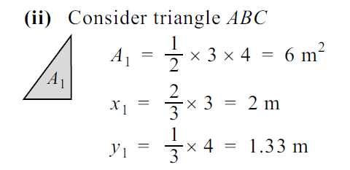
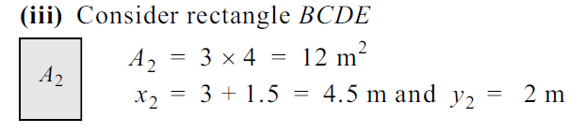
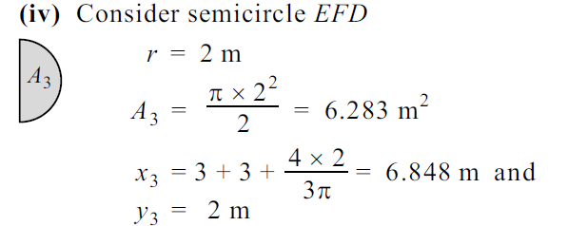

Slide 13
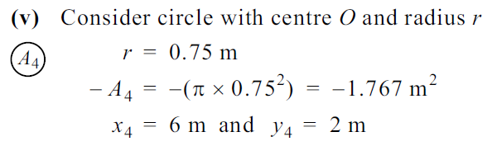
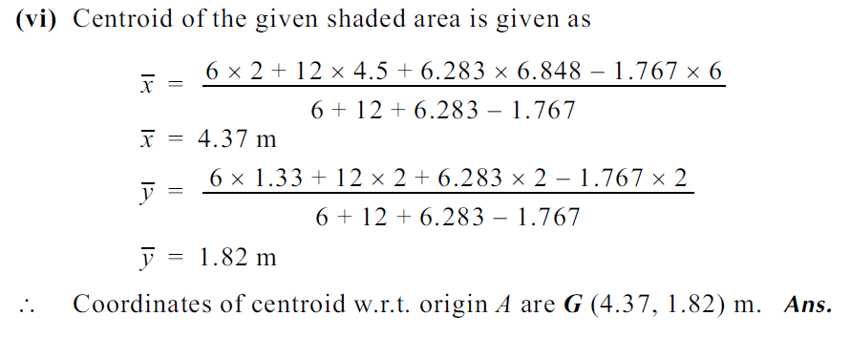

Slide 14
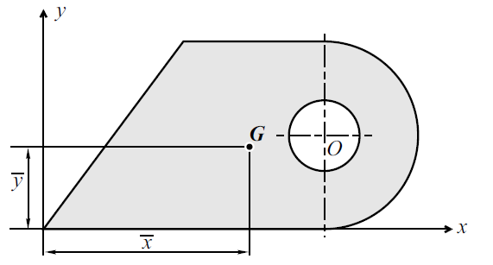
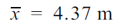
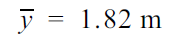

Slide 15
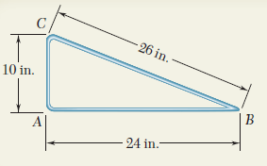
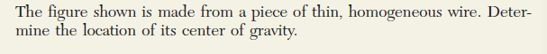
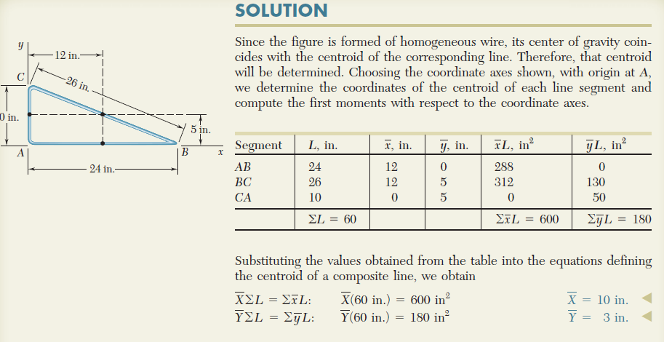

Slide 16
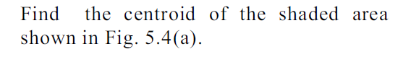
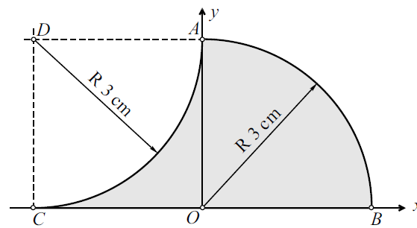

Slide 17
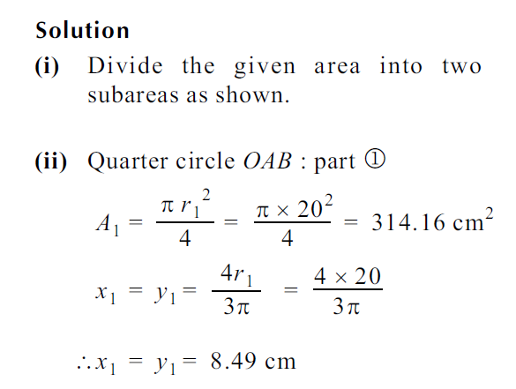
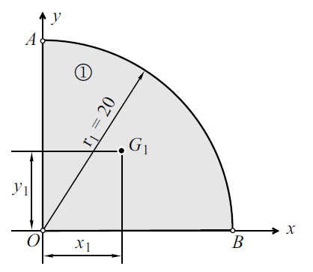

Slide 18
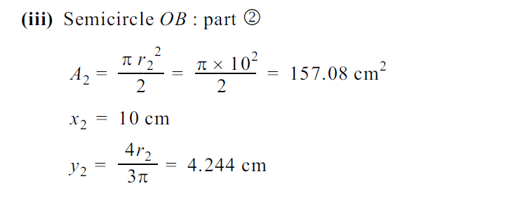
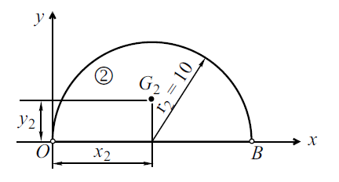

Slide 19
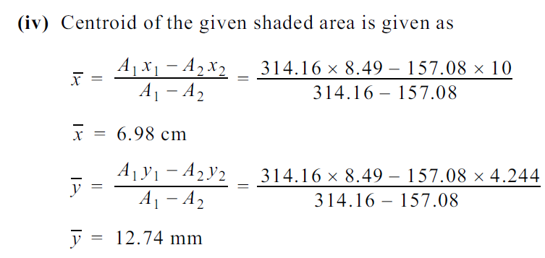
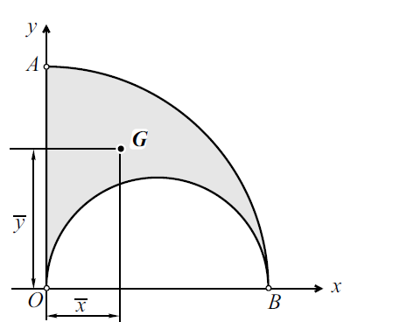

Slide 20
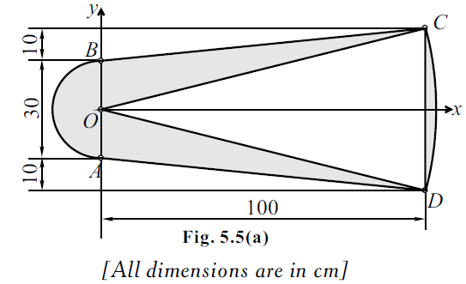

Slide 21
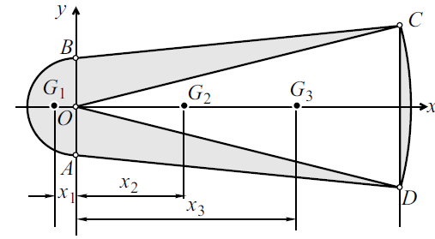
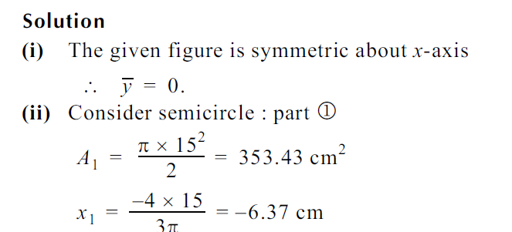

Slide 22
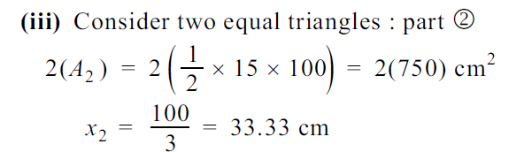
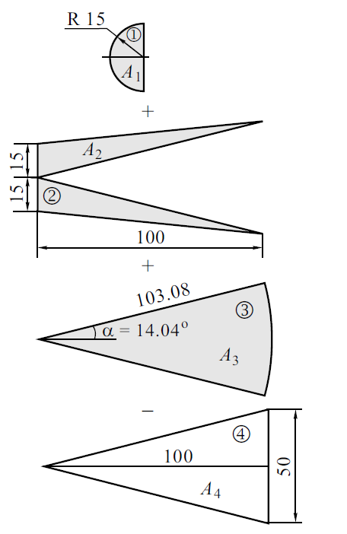
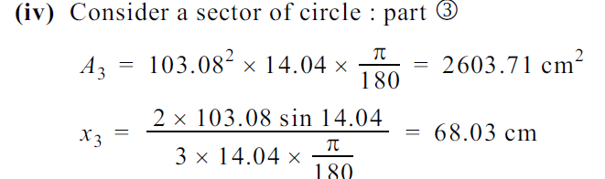
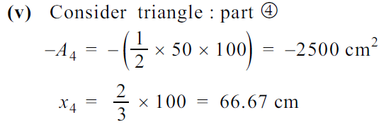

Slide 23
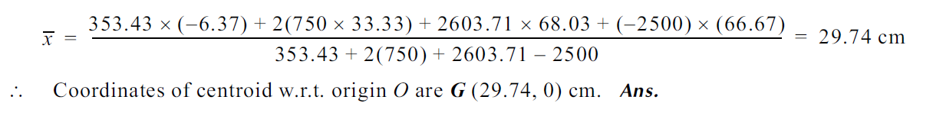

Slide 24
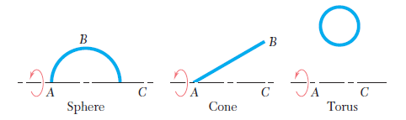

Slide 25
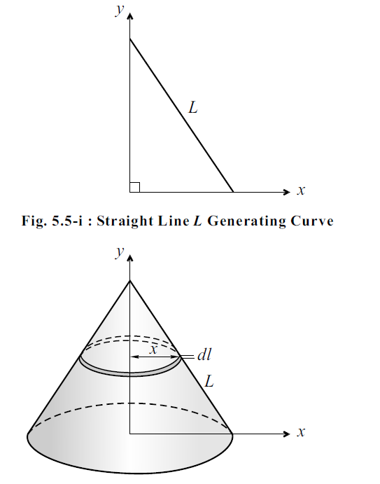
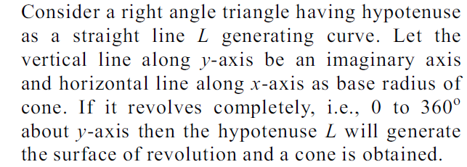

Slide 26
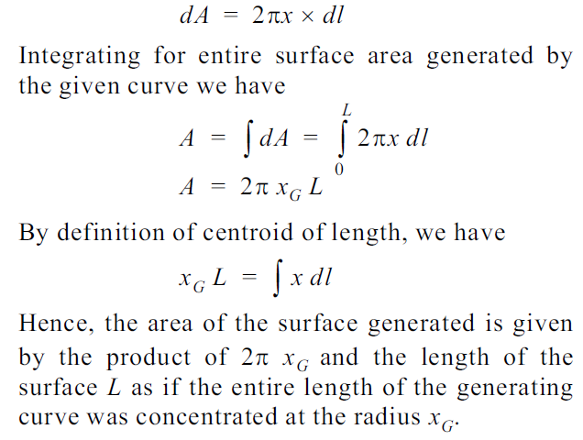

Slide 27


Slide 28


Slide 29



Slide 30


Slide 31


Slide 32



Slide 33





Slide 34


Slide 35


Slide 36


Slide 37



Slide 38



Slide 39


Slide 40


Slide 41


Slide 42


Slide 43






Slide 44



Slide 45






Slide 46







Slide 47



Slide 48


Slide 49



Slide 51




Slide 52





Slide 53



Slide 54


Slide 55


Slide 56



Slide 57



Slide 58




Slide 59


Slide 60


Slide 61


Slide 62


Slide 63


Slide 64


Slide 65


Slide 66



Slide 67



Slide 68



Slide 69








Slide 70





Slide 71




Slide 72


Slide 73


Slide 74


Slide 75


Slide 76


Slide 77

Determine Moment of inertia about x axis.
Component | I_{Gx}’ (cm⁴) | Area (cm²) | dy (cm) | M I about Base (ox) (cm⁴) Ixx = I_{Gx} + A dy²
Rectangle (+ve) | -- | -- | --
Triangle (+ve)
Semicircle (-ve)
 |  |  |  | =

Slide 78
Determine Moment of inertia about x axis.
Component | I_{Gx}’ (cm⁴) | Area (cm²) | dy (cm) | M I about Base (ox) (cm⁴) Ixx = I_{Gx} + A dy²
Rectangle (+ve) | -- | -- | --
Triangle (+ve)
Semicircle (-ve)
 |  |  |  | =

Slide 79

Determine Moment of inertia about x axis.

Slide 80

Determine Moment of inertia about x axis.
Component | I_{Gx} (cm⁴) | Area (cm²) | dy (cm) | Ixx = I_{Gx}+ A r² (cm⁴)
Square ABDE (+ve)
Triangle (AEF) (+ve) + Triangle (BDC) (+ve)
Q. Circle AD (-ve) |  |  | = - (5-4r/3π)= 5- 2.122 = - 2.878
TOTAL
0.055 (5)⁴
= 34.375

Slide 81
Determine Moment of inertia about x axis.

Slide 82

Determine Moment of inertia about x axis.
Component | I_{Gx}’ (cm⁴) | Area (cm²) | dy (cm) | M I about Base (ox) (cm⁴) Ixx = I_{Gx} + A dy²
Rectangle ABOE (+ve)
Semicircle BDE (+ve)
Triangle COE (-ve)
Circle (-ve)

Slide 83

Determine Moment of inertia about x axis.
Component | I_{Gx}’ (cm⁴) | Area (cm²) | dy (cm) | M I about Base (ox) (cm⁴) Ixx = I_{Gx} + A dy²
Rectangle ABOE (+ve) | -- | -- | -- | bd³/3 = 15 x 20³/3 = 40000
Semicircle BDE (+ve) | =$\frac{π}{8}$ r⁴ OR $\frac{π}{128}$ D⁴ = 3927 | $\frac{π}{2}$ (10)²=157.079 | 10 | = 3927+ 157.079(10²) =19634.96
Triangle COE (-ve) | -- | -- | -- | = - bh³/12 = - 15 x 10³/12 = - 1250
Circle (-ve) | =$\frac{π}{4}$ r⁴ OR $\frac{π}{64}$ D⁴ = 12.566 | $π$ (2)² = 12.566 | 15 | = - (12.566 + 12.566 (15²)) = - 2839.916
 |  |  |  | = 55545.044

Slide 84

Determine Moment of inertia about x axis.
Component | I_{Gx}’ (cm⁴) | Area (cm²) | dy (cm) | M I about (CD) (cm⁴) Ixx = I_{Gx} + A dy²
Rectangle ABOC (+ve)
Semicircle BDE (+ve)
Triangle COE (+ve)
circle (-ve)
Q. circle (-ve)

Slide 85
Determine Moment of inertia about y axis.
Component | I_{Gy}’ (cm⁴) | Area (cm²) | dx (cm) | M I about Base (ox) (cm⁴) Iyy = I_{Gy} + A dx²
Rectangle ABOE (+ve)
Semicircle BDE (+ve)
Triangle COE (-ve)
Circle (-ve)

Slide 86

Determine Moment of inertia about centroidal x-axis and y-axis.

Slide 87

Determine centroid of the shaded area shown in figure.

Slide 88
Determine Moment of inertia about x-axis and y-axis.

